Slide 1
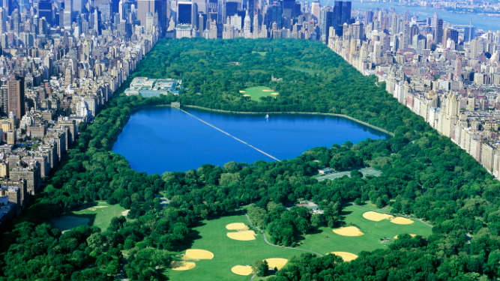
New York Tree Study
By: Andrew Dodds & Harika Patel
ALY6070 – Northeastern University

Slide 2
Introduction
Information regarding the tree's health, Location and Damage will be used to answer business questions related to recent efforts to improve the natural ecosystem within the city.
The City of New York has provided a data set of 683788 observations of 45 attributes from a survey from NYC Park Staff and volunteers .
This dataset contains information from each of the five boroughs for our team to analyze.

Slide 3
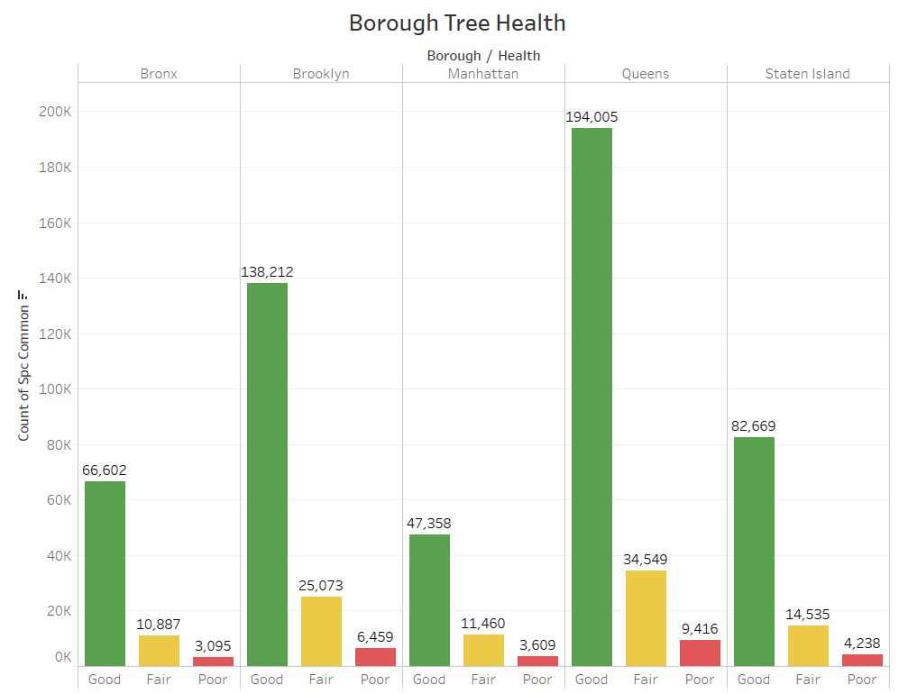
Tree Health Overview

Slide 4
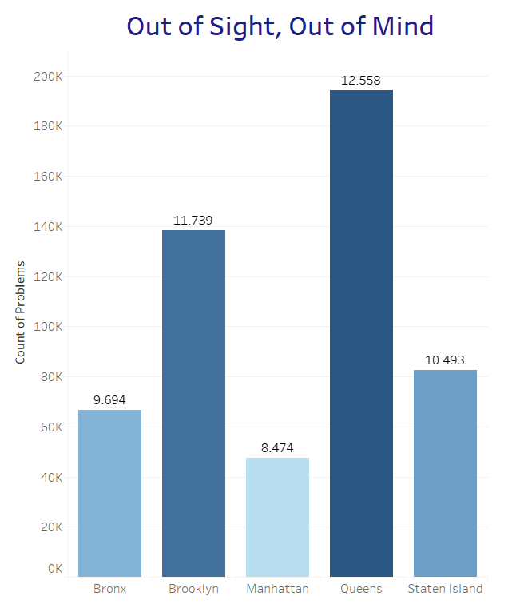
Girth and Problem Analysis
Analysis:
Trees with larger girth are older and taller, requiring a larger and secure root system and long branches. These ultimately attract more vandalism with shoes or cause damage to sidewalks.
Suggestion:
Remove Trees With Large Girth Capable of Causing Sidewalk Damage or Attract Vandalism

Slide 5
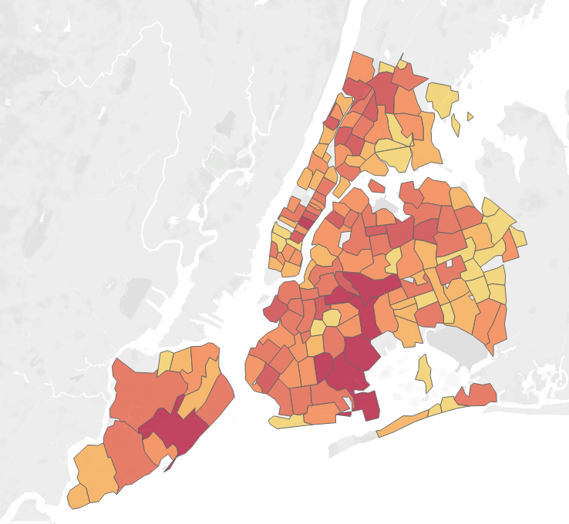
Funds Needed in Manhattan and Queens
Analysis: Zip codes within Staten Island and Queens require immediate attention. The number of problem occurrences are notably greater in the areas indicated in red.
Suggestion: Re-Allocate funds for NYC Parks staff to monitor and maintain these areas for 6 months and re-evaluate progress.

Slide 6
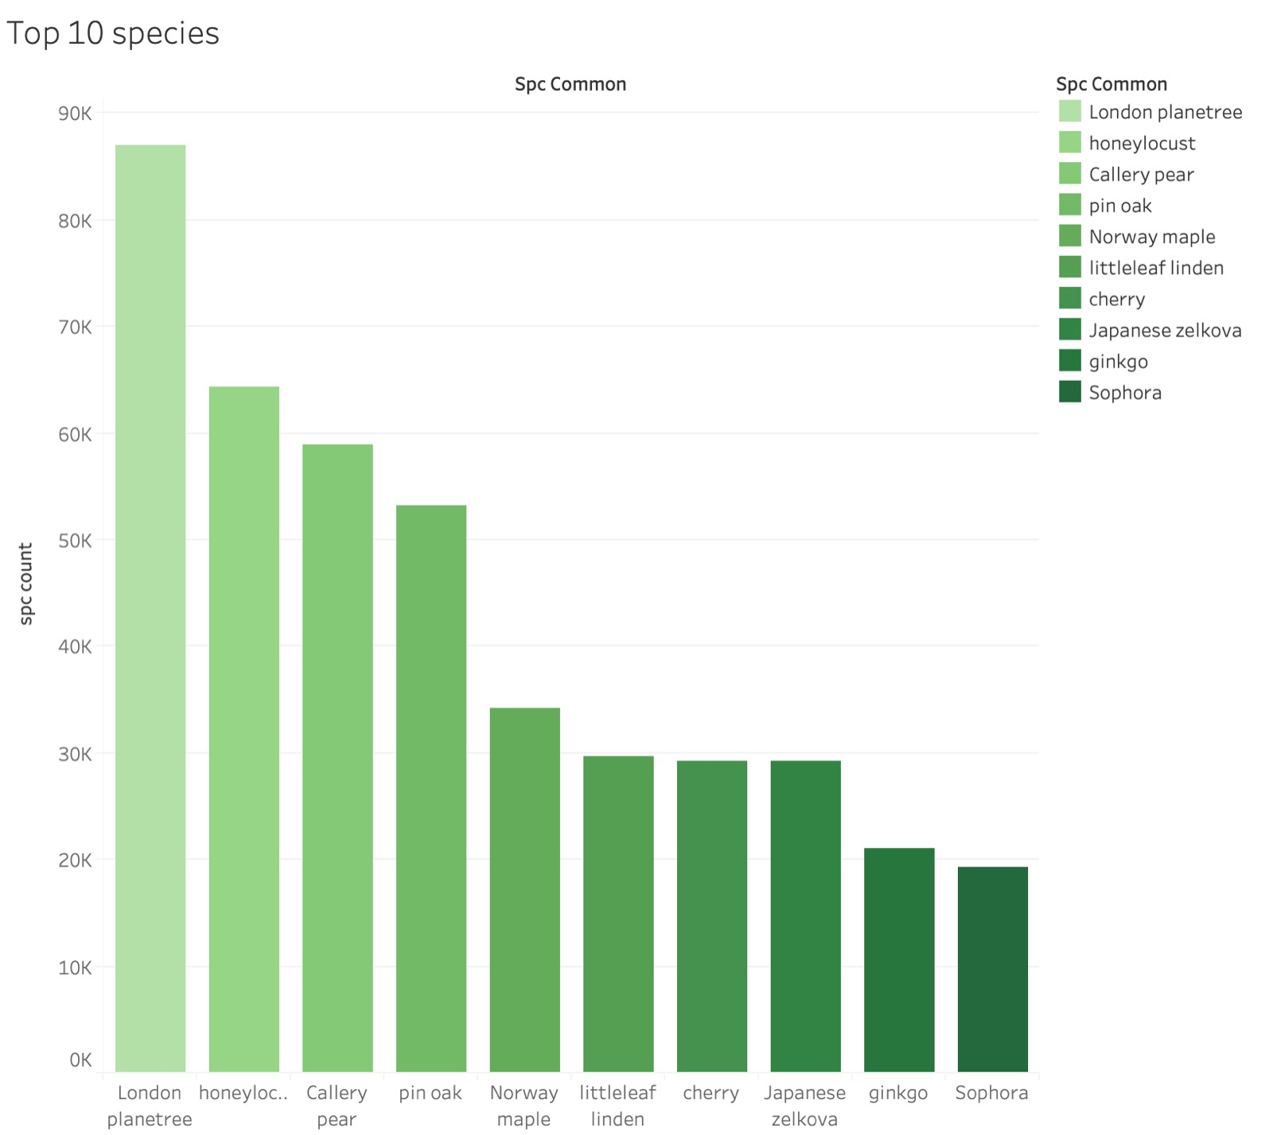
Horticulture Required Knowledge:
Business Question: NYC Parks staff only has enough resources to train personnel on 10 learning units. How would the park best spend these learning credits.
Recommendation: The most effective method for allocating learning units would be to offer seminars in the top 10 most common species of trees in NY.

Slide 7
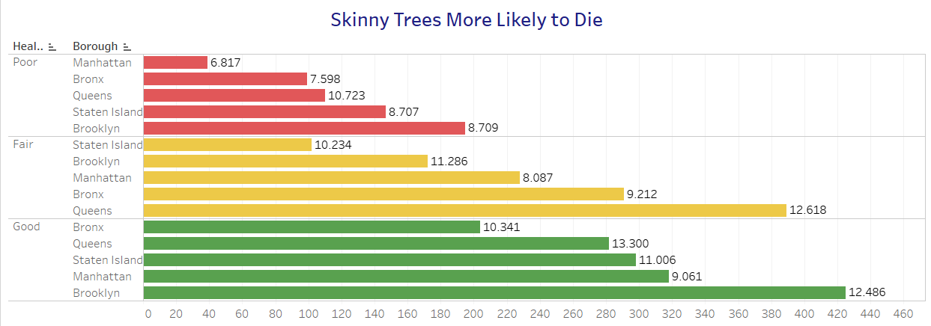
Skinny Trees More Likely to Die
Business Question: Outside of the tree specie, how can volunteers recognize which trees more care?
Suggestion: Trees with a width in all 5 Boroughs with a width less than 11inches should be inspected for disease and diagnosis

Slide 8



Conclusion
Saplings with a diameter below 10Inches should be allocated greater resources
Queens has the most healthy and sick trees! More NYC Parks staff should be assigned to this borough
Remove trees in Queens and Manhattan with long branches to avoid damage from shoes and to sidewalks

